Slide 1

Expanding your CI/CD pipeline
*The good, the bad and the life ruining*

Slide 2











Slide 3

Who Are We?

Slide 4


Slide 5
Eelco Drost
SQL Server Engineer
Data MasterMinds
@eelcodrost
Eelco@datamasterminds.io
Rob Sewell
Automator
Sewells Consulting
@sqldbawithbeard
Rob@Sewells-Consulting.co.uk

Slide 6
Today We Shall
Expect that you understand CI/CD with data (a bit more...)
Take a look at SQLPackage
Examine Publish Profiles
Talk about and overcome difficulties
Have a bit of fun along the way – It’s ok to laugh!

Slide 7
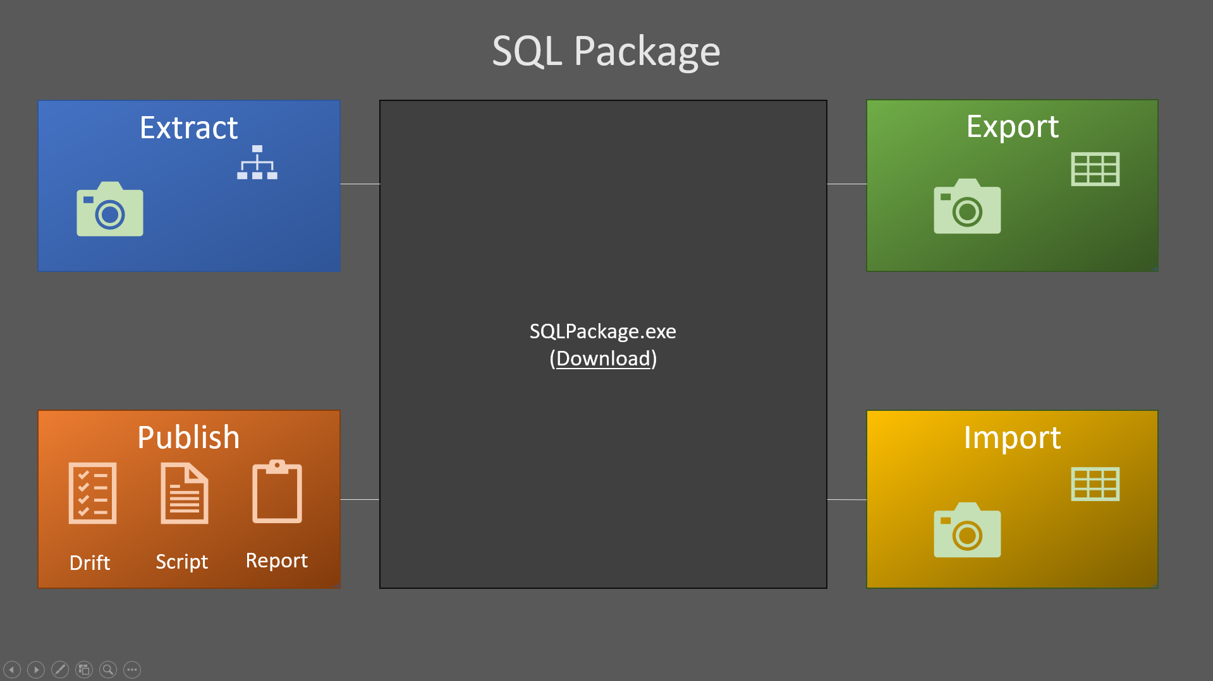

Our focus for today!

Slide 9
Compares the target (SQL Server or Azure SQL DB) or a DACPAC with the source DACPAC.
SqlPackage /Action:DriftReport /TargetServerName: <ServerName> /TargetDatabaseName: <DatabaseName> /OutputPath Deploy_DriftReport.xml
Can create a drift report with all the changes that have been made since registering

Slide 10
Compares the target (SQL Server or Azure SQL DB) or a DACPAC with the source DACPAC.
SqlPackage /Action:Script /TargetServerName: <ServerName> /TargetDatabaseName: <DatabaseName> /SourceFile: “<DACPAC File Path>” /OutputPath: “<Path for Output Files>”
Can create an incremental update script to match source and target

Slide 11
Compares the target (SQL Server or Azure SQL DB) or a DACPAC with the source DACPAC.
SqlPackage /Action:DeployReport /TargetServerName: <ServerName> /TargetDatabaseName: <DatabaseName> /SourceFile: “<DACPAC File Path>” /OutputPath: “<Path for Output Files>”
Can create a deploy report with all the changes

Slide 12
5 steps in the Publish Phase:
Schema Comparison

Slide 13
5 steps in the Publish Phase:
Schema Comparison
Schema Difference Generation

Slide 14
5 steps in the Publish Phase:
Schema Comparison
Schema Difference Generation
Execute Pre Deployment

Slide 15
5 steps in the Publish Phase:
Schema Comparison
Schema Difference Generation
Execute Pre Deployment
Execute generated script

Slide 16
5 steps in the Publish Phase:
Schema Comparison
Schema Difference Generation
Execute Pre Deployment
Execute generated script
Execute Post Deployment

Slide 17
Merged into one script and executed against the target
Schema Comparison
Schema Difference Generation
Execute Pre Deployment
Execute generated script
Execute Post Deployment

Slide 18
Pre Deployment scripts have NO EFFECT on Schema Comparison
Schema Comparison
Schema Difference Generation
Execute Pre Deployment
Execute generated script
Execute Post Deployment

Slide 19
Options: – Good to know!
Publish Profile Options
only apply here
Schema Comparison
Schema Difference Generation
Execute Pre Deployment
Execute generated script
Execute Post Deployment

Slide 20

Demo: – Eelco’s Useful Tips
on publish profile options
Notes:
Demos:
Deploy database properties
Block on Possible Dataloss
IGNORE: Partition Schemes
EXCLUDE Partition Schemes

Slide 21


”But I really want to drop that column”

Slide 22
”Yay!”
Use Pre and Post deployment scripts (2 publish actions needed)
Use Publish Profiles
Turn off “Block on possible data loss” temporarily
Use a pre-pre deployment script ☺
Notes:
https://blogs.msdn.microsoft.com/gertd/2009/09/14/pre-deployment-scripts/
https://github.com/lobodava/dac-deployer
https://stackoverflow.com/questions/32330699/dacpac-schema-compare-runs-before-pre-deployment-scripts-during-publish

Slide 23
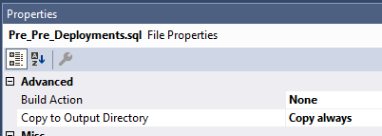
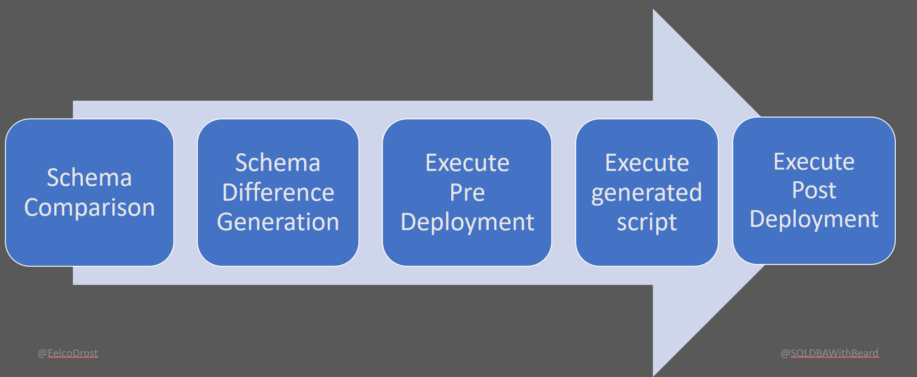
Pre-Pre-Deploymentscript
(Combining State and Migration based deployment)
Execute
Pre-Pre
Deployment

Slide 24


Data in source control

Slide 25
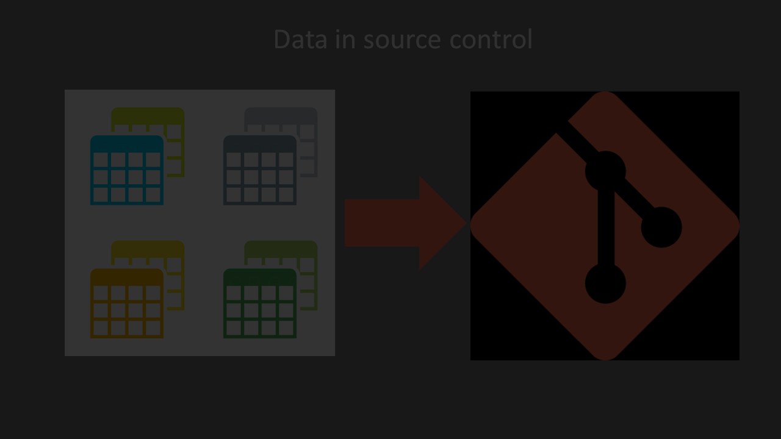
Data in source control

Slide 26

Data in source control
Not For Big Tables!

Slide 27

Data in source control
Perfect (Recommended)
For lookup tables

Slide 28
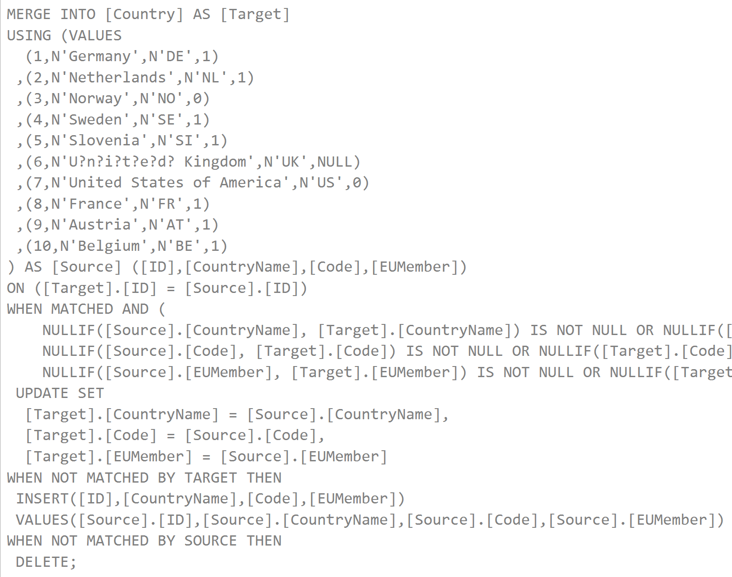
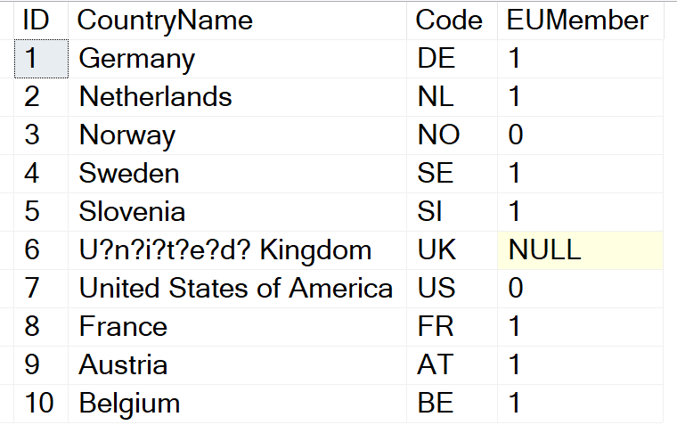
Data in source control
In the Pre or Post
Deployment Script
Notes:
sp_generate_merge
https://github.com/readyroll/generate-sql-merge

Slide 29
Data in source control
https://github.com/readyroll/generate-sql-merge
EXEC sp_generate_merge @schema = 'dbo', @table_name ='ShippingCountry'

Slide 30

What about transactions....
BEGIN TRAN
Pre
ALTER TABLE Foo
ADD Bar int
Script
COMMIT / ROLLBACK TRAN
Post
Photo by Evan Dennis on Unsplash

Slide 31
Demo
Notes:
Demos:
Publish Profiles
Merge statement
SP_GENERATE_MERGE
Transactions (merge of Pre, POST and Deploy script)
How to add Pre-Pre_Deploymentscript

Slide 32
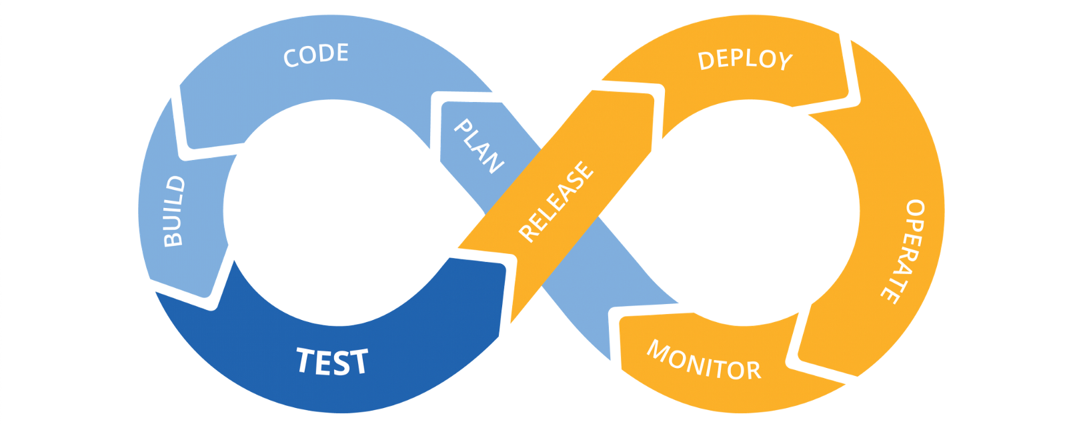


Slide 33
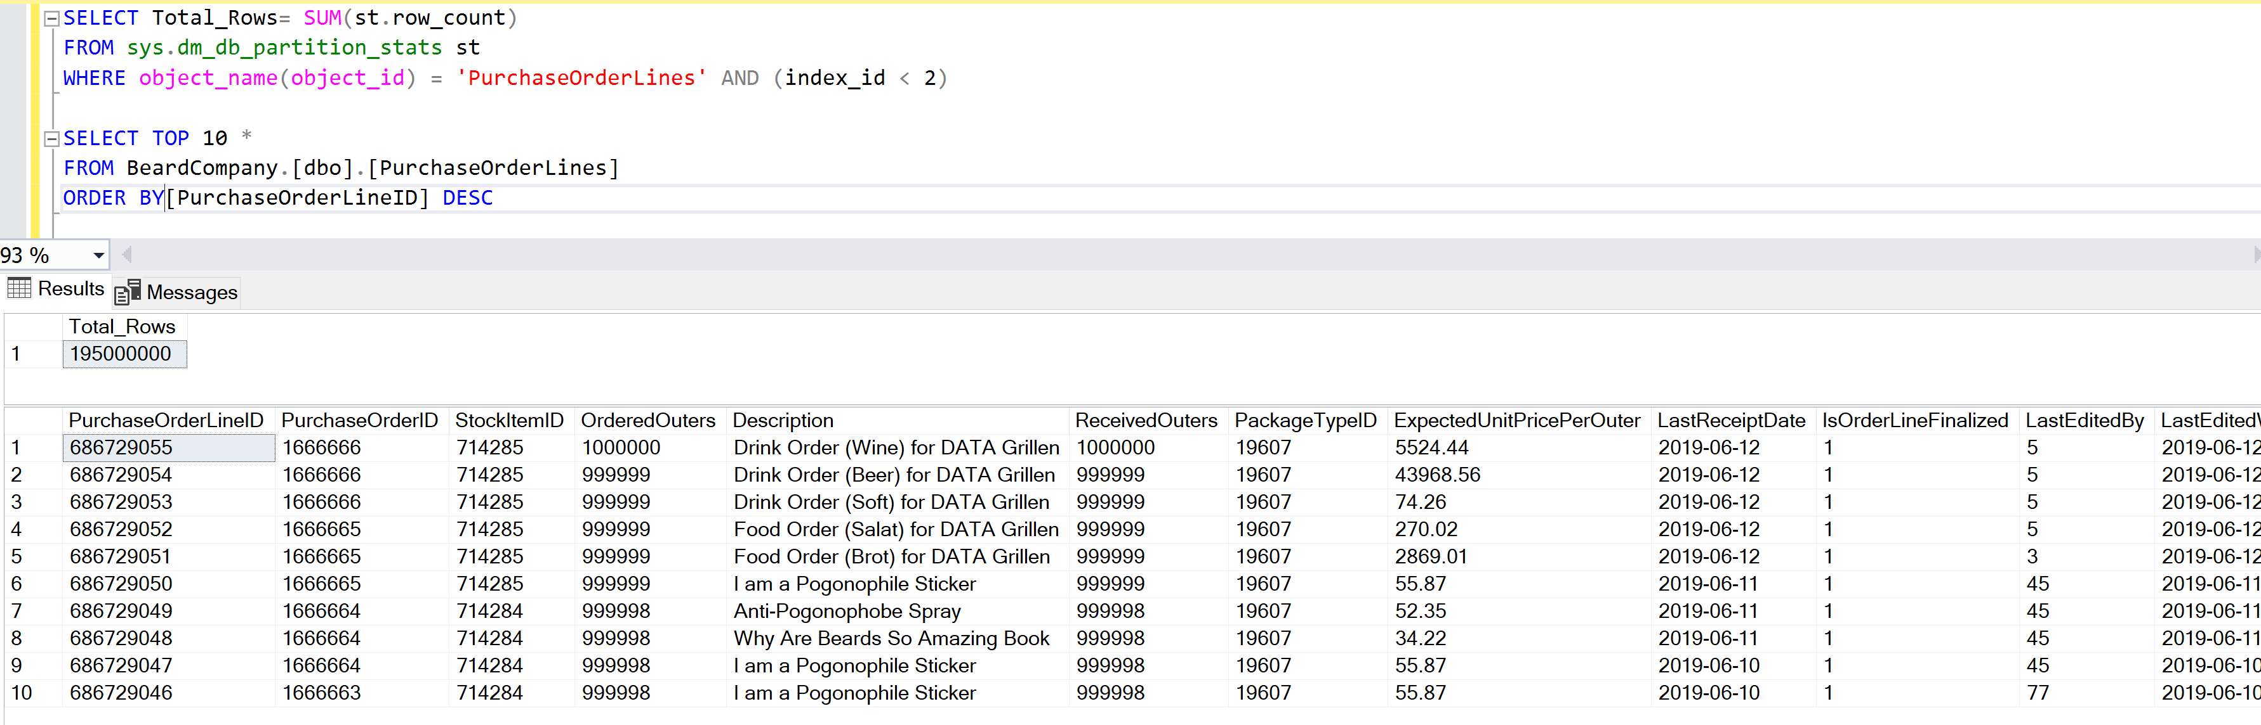
But Sometimes

Slide 34


But Sometimes
I just need to alter this table
NO! You can’t have that much downtime
Dev
%*^$ But that will take 5 hours
DBA
The Business

Slide 35


Slide 36
Dev
Change

Slide 37
I do more than check which objects Beardy!
Dev
Change
Check Which Objects
DBA

Slide 38
View, Stored Procedure or small table
Dev
Change
Check Which Objects
DBA

Slide 39
View, Stored Procedure or small table
Test and Deploy
Dev
Change
Check Which Objects
DBA

Slide 40
Dev
Change
Check Which Objects
DBA

Slide 41
Dev
Change
Check Which Objects
DBA
Big Table

Slide 42
Dev
Change
Check Which Objects
DBA
Stop Wait for Correct Window
Big Table

Slide 43
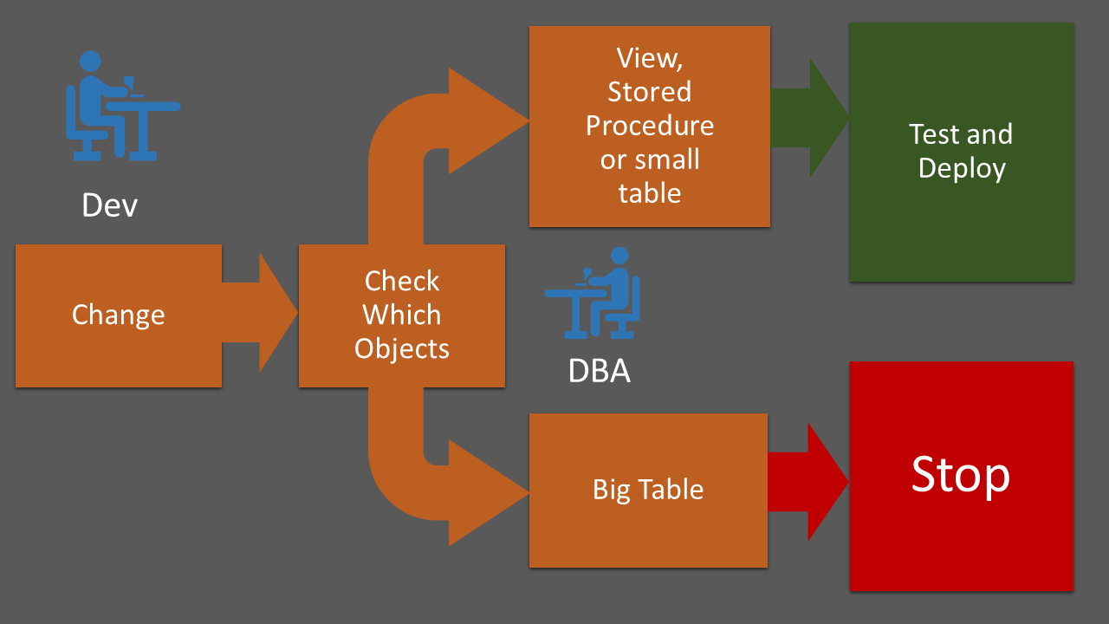
Demo

Slide 44
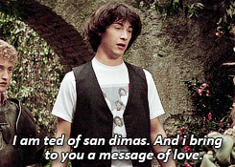
Demo

Slide 45


Slide 46

Just like Jimi Hendrix …
We love to get feedback
Please complete the
session feedback forms

Slide 47

Session Feedback (not optional!!)
http://bit.ly/DataGrillen2019Day1

Slide 48

Event Feedback (not optional!!)
http://bit.ly/DataGrillen2019Event

